Slide 1
Computer Vision and Deep Learning
Lecture 10

Slide 2
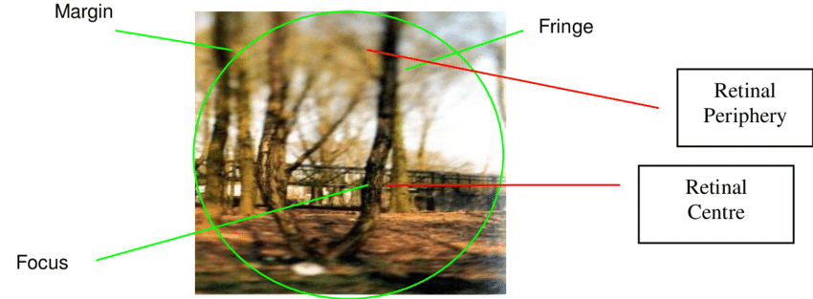
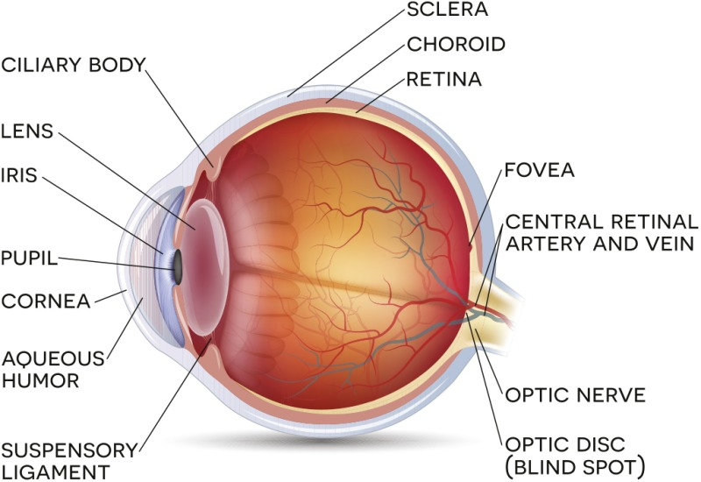
Attention
humans exploit a sequence of partial glimpses and selectively focus on salient parts in order to capture visual structure better
https://www.researchgate.net/figure/Spotlight-model-of-visual-attention-The-attentional-spotlight-and-visual-sensitivity-is_fig5_266283321

Slide 3
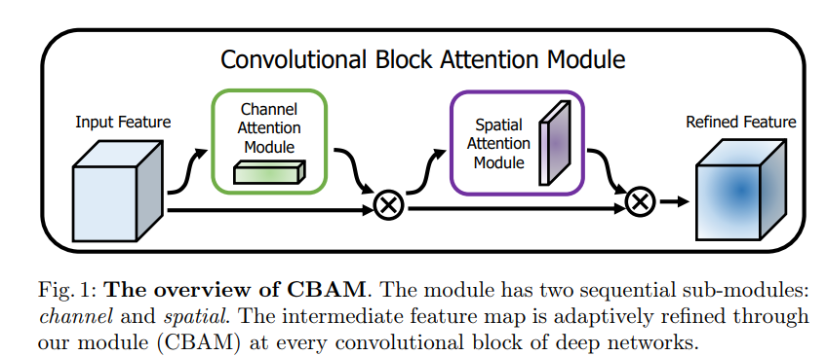
CBAM – Convolutional Block Attention Module
Convolutional Block Attention Module (CBAM):
a simple yet effective attention module for feed-forward convolutional neural networks
https://openaccess.thecvf.com/content_ECCV_2018/papers/Sanghyun_Woo_Convolutional_Block_Attention_ECCV_2018_paper.pdf

Slide 4
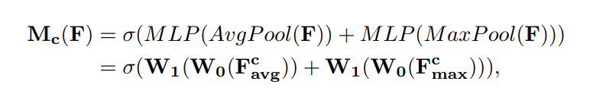
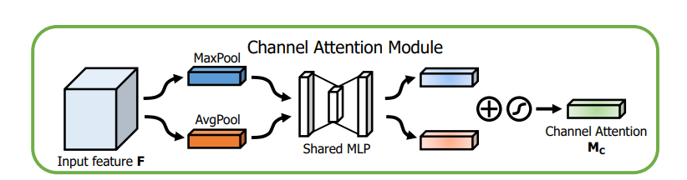
Channel Attention
GAP(Global Average Pooling)
Aggregate spatial information
GMP
Preserve richer context information
Multilayer perceptron (MLP)
Sigmoid activation
Gives the weights for each channel
https://openaccess.thecvf.com/content_ECCV_2018/papers/Sanghyun_Woo_Convolutional_Block_Attention_ECCV_2018_paper.pdf

Slide 5
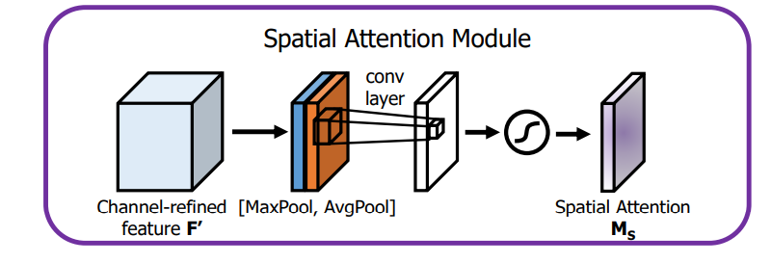
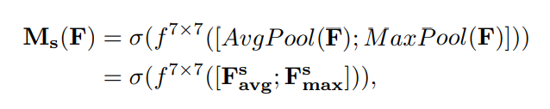
Spatial Attention
Two pooling operations
1x1 Conv
Sigmoid activation
Can be applied element-wise to all the positions in the input feature map
https://openaccess.thecvf.com/content_ECCV_2018/papers/Sanghyun_Woo_Convolutional_Block_Attention_ECCV_2018_paper.pdf

Slide 6
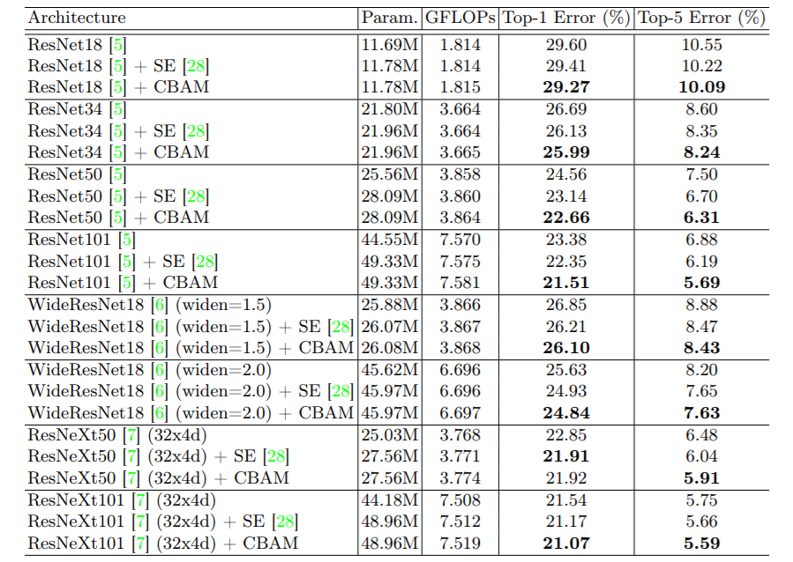
CBAM – Convolutional Block Attention Module
https://openaccess.thecvf.com/content_ECCV_2018/papers/Sanghyun_Woo_Convolutional_Block_Attention_ECCV_2018_paper.pdf

Slide 7
Recurrent neural networks
Other resources:
RNNs: http://karpathy.github.io/2015/05/21/rnn-effectiveness/ (HIGHLY RECOMMENDED)
https://www.youtube.com/watch?v=yCC09vCHzF8
https://colah.github.io/posts/2015-08-Understanding-LSTMs/
Self attention and transformers (Stanford lecture 2021): https://www.youtube.com/watch?v=ptuGllU5SQQ
Jay Alammar series on Transformers & BERT:
https://jalammar.github.io/illustrated-transformer/
https://jalammar.github.io/visualizing-neural-machine-translation-mechanics-of-seq2seq-models-with-attention/
https://jalammar.github.io/illustrated-bert/

Slide 8
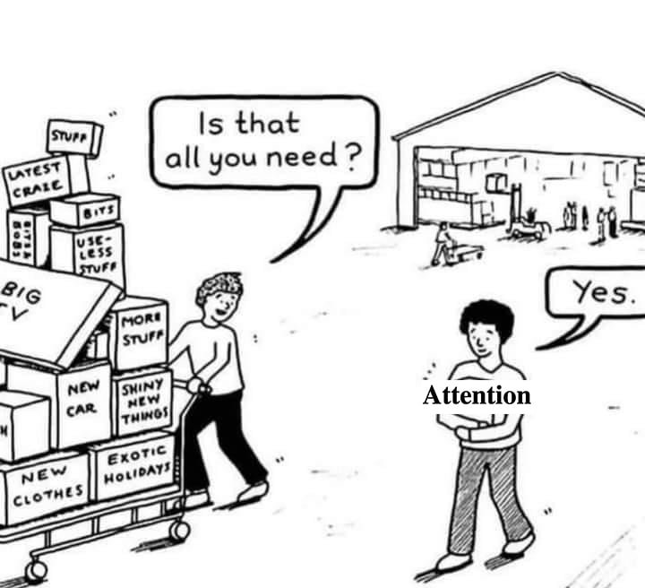
Attention is all you need
https://arxiv.org/abs/1706.03762

Slide 9
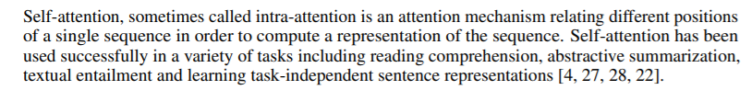
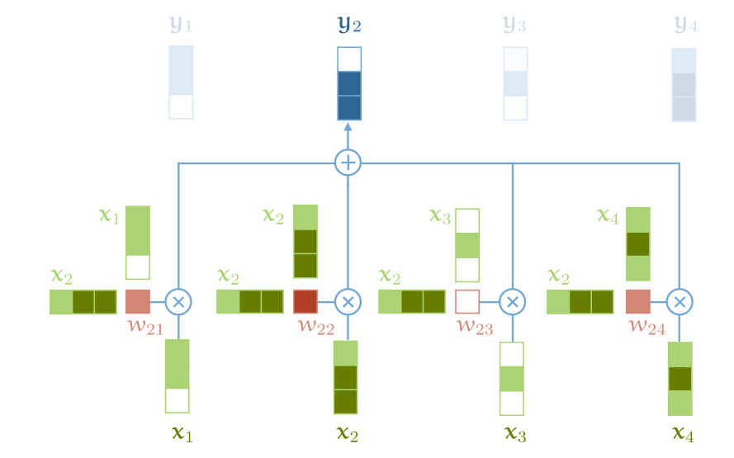
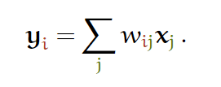
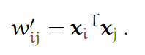
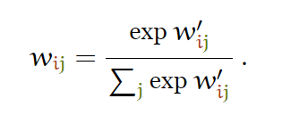
Self attention
http://peterbloem.nl/blog/transformers

Slide 10
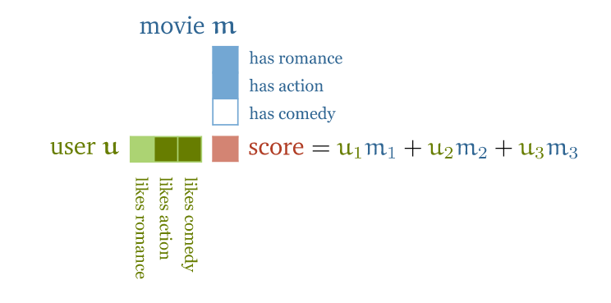
Self attention
http://peterbloem.nl/blog/transformers

Slide 11
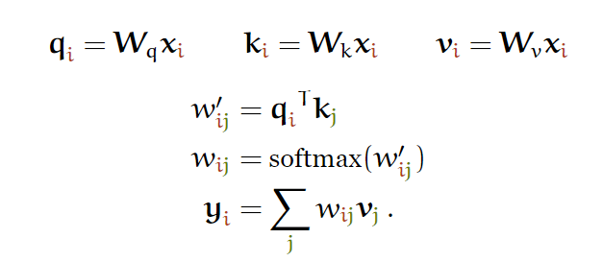
Attention: query, keys and values
“An attention function can be described as mapping a query and a set of key-value pairs to an output, where the query, keys, values, and output are all vectors.”

Slide 12
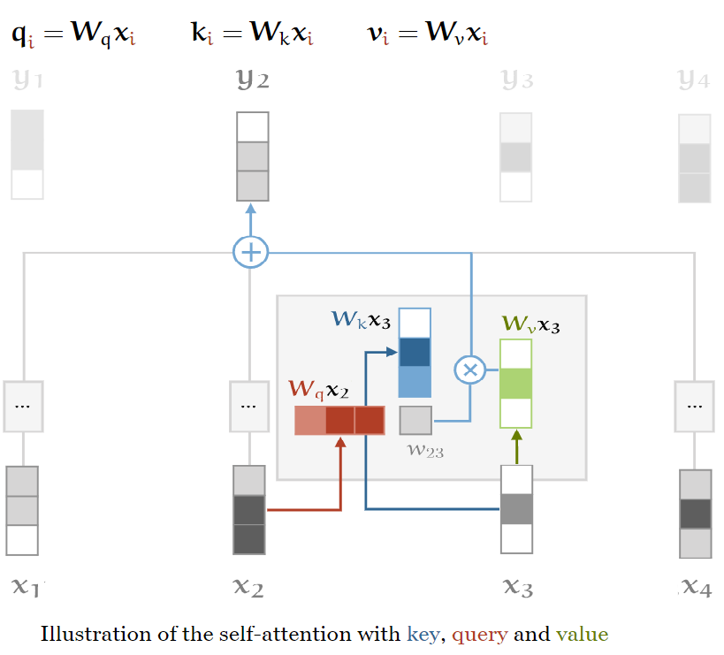
Attention: query, keys and values

Slide 13
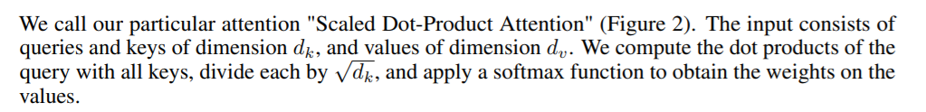
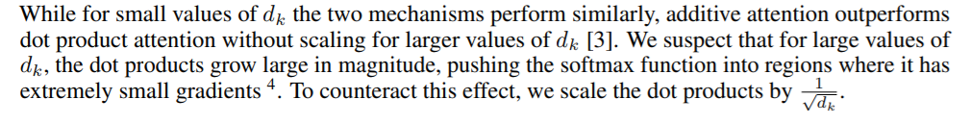
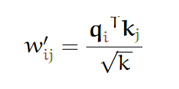
Scaled Dot-Product Attention
k(d_{k} in the paper) – dimension of the embedding

Slide 14
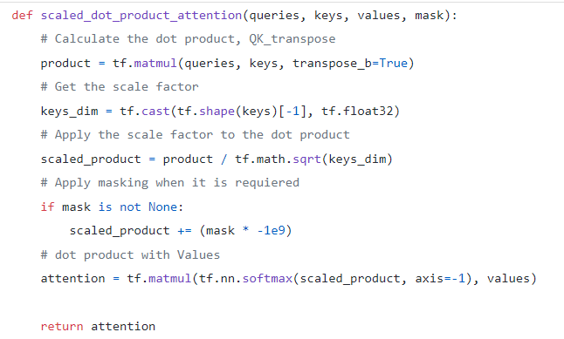

Slide 15
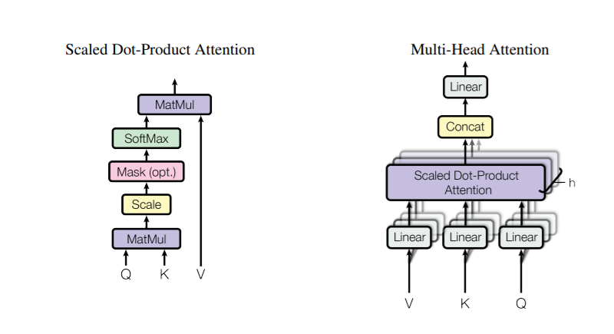
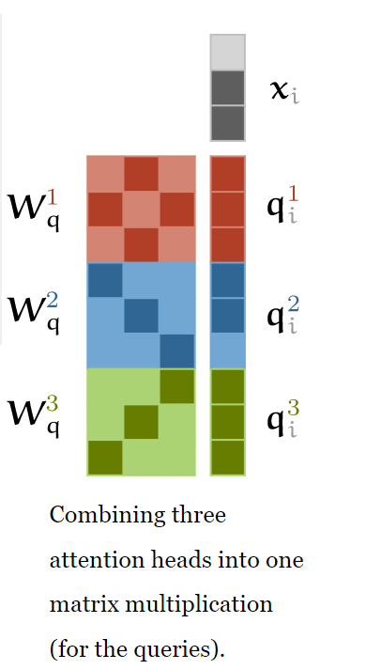
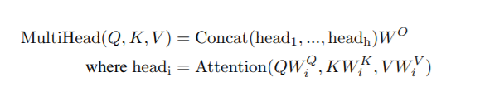
Multi-head attention

Slide 16
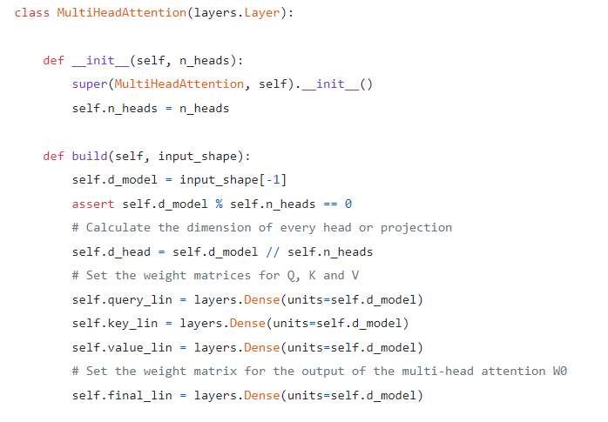
https://towardsdatascience.com/attention-is-all-you-need-discovering-the-transformer-paper-73e5ff5e0634

Slide 17
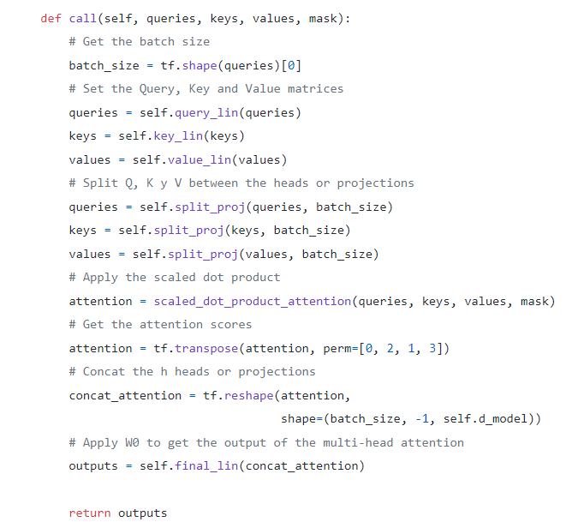
https://towardsdatascience.com/attention-is-all-you-need-discovering-the-transformer-paper-73e5ff5e0634

Slide 18
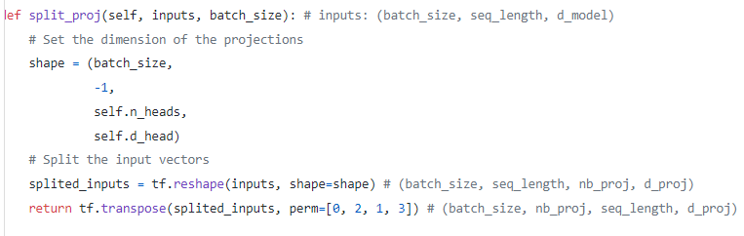
https://towardsdatascience.com/attention-is-all-you-need-discovering-the-transformer-paper-73e5ff5e0634

Slide 19
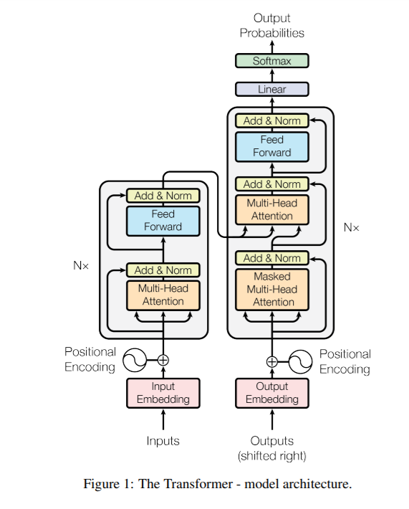
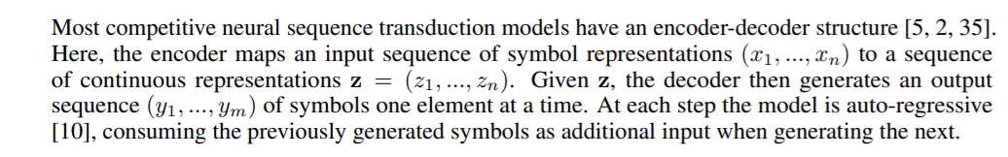
Transformer architecture

Slide 20
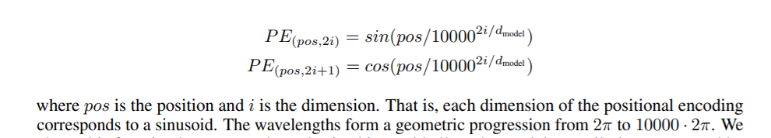
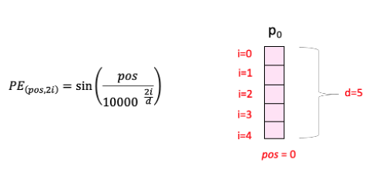
Positional Encoding

Slide 21
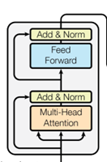
Transformer: encoder block
Multi head attention layer
Layer normalization
Feed forward layer (applied independently to each vector)
Layer normalization
+ Residual connections (before the normalizations)

Slide 22
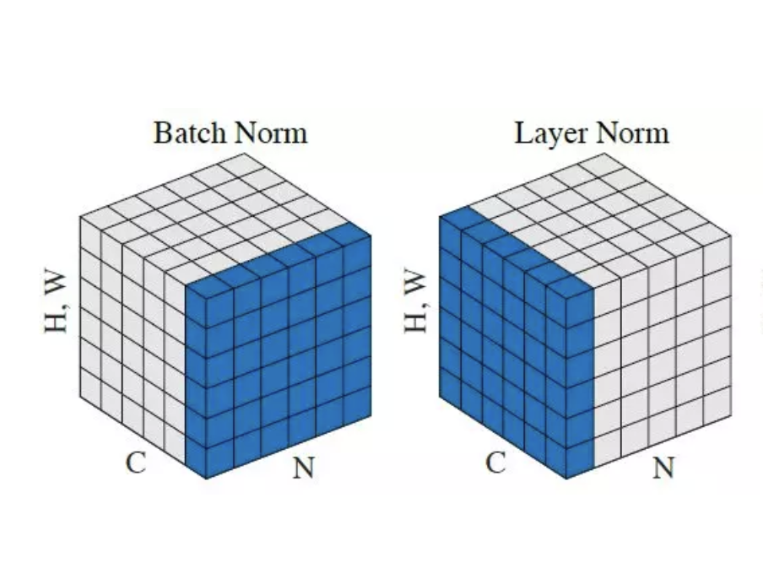
Batch norm vs Layer norm

Slide 23
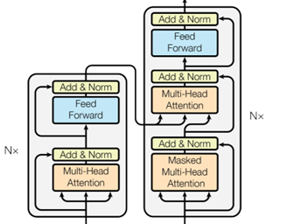
Transformer: decoder block
Input: block on the same level in the encoder and the previous level in the decoder
Masked multi head attention

Slide 24
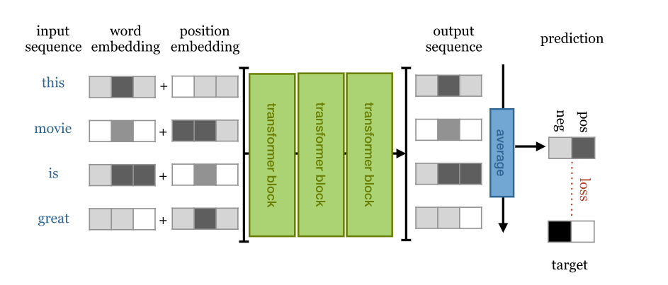
Simple transformer for sentiment analysis

Slide 25
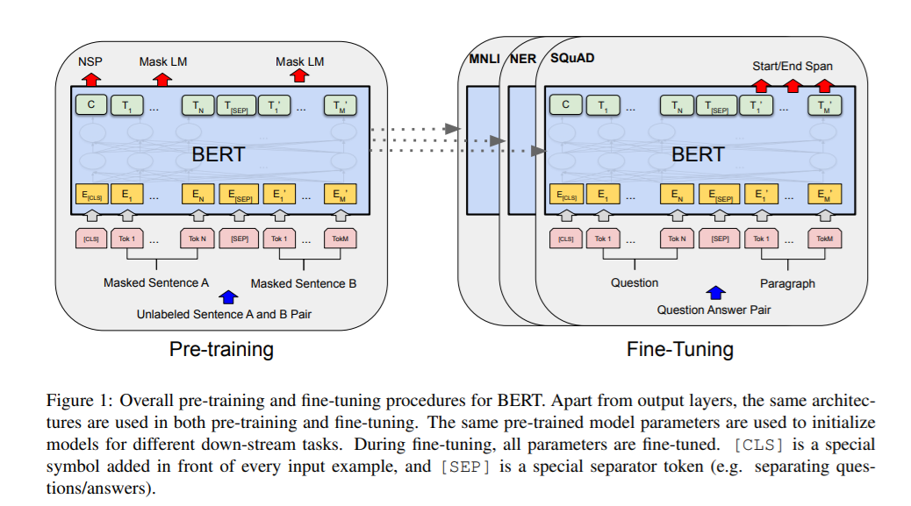
BERT
https://jalammar.github.io/a-visual-guide-to-using-bert-for-the-first-time/

Slide 26
BERT
PRE-TRAINED on a large general-domain corpus consisting of 800M words from English books 2.5B words of text from English Wikipedia articles.
Masking: words are masked out, replaced with a random word or kept as they are. The model is then asked to predict, for only these words, what the original words were.

Slide 27
BERT
PRETRAINING
Masking
Next Sentence Prediction: Two sequences of about 256 words are sampled that either (a) follow each other directly in the corpus, or (b) are both taken from random places. The model must then predict whether a or b is the case.

Slide 28
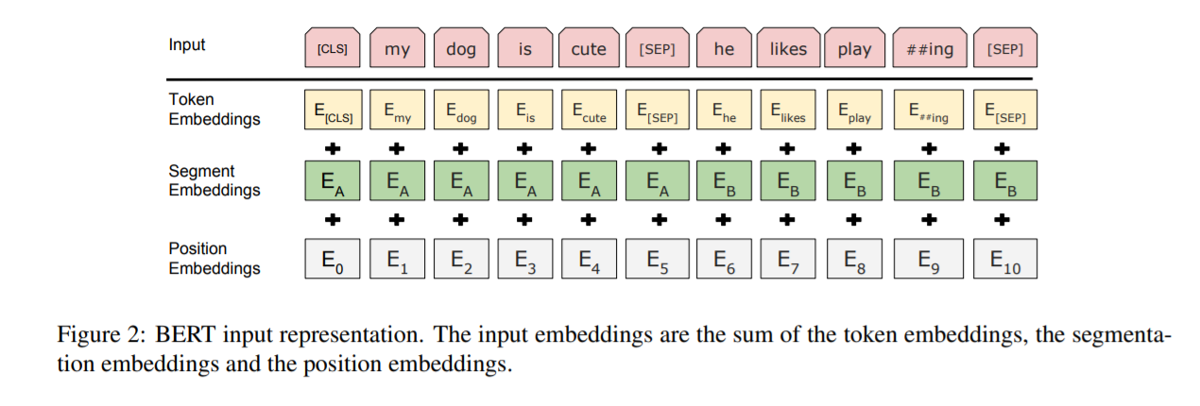
BERT
Input is prepended with a special <CLS> token. The output vector corresponding to this token is used as a sentence representation in sequence classification tasks like the next sentence classification.

Slide 29
BERT
FINE-TUNING
a single task-specific layer is placed after the transformer blocks, which maps the general purpose representation to a task specific output.
Classification: maps the first output token (corresponding to <CLS>) to softmax probabilities over the classes

Slide 30
An Image is Worth 16x16 Words: Transformers for Image Recognition at Scale
Vision transformer

Slide 31
Official implementation in JAX: https://github.com/google-research/vision_transformer#vision-transformer

Slide 32
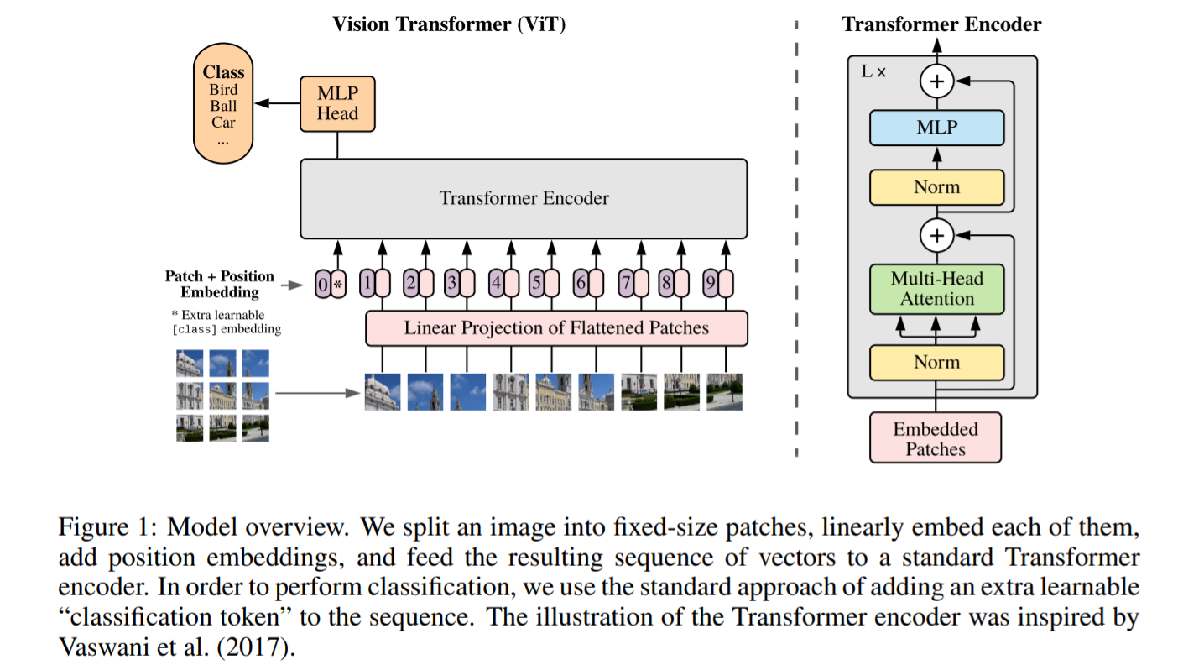

Slide 33
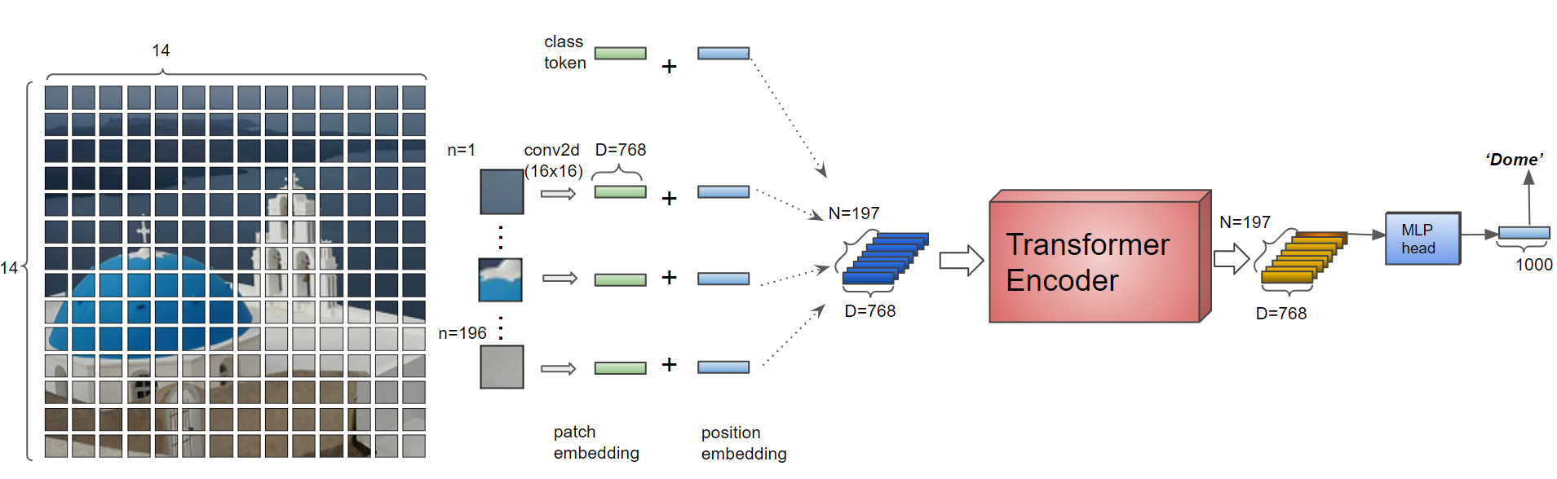
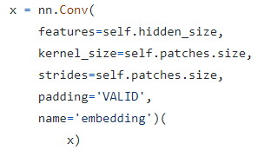
1. Split the image into patches and encode each patch
https://colab.research.google.com/github/hirotomusiker/schwert_colab_data_storage/blob/master/notebook/Vision_Transformer_Tutorial.ipynb#scrollTo=nI6rRunEO6bI

Slide 34
Split the image into patches and encode each patch
Add Position Embeddings
https://colab.research.google.com/github/hirotomusiker/schwert_colab_data_storage/blob/master/notebook/Vision_Transformer_Tutorial.ipynb#scrollTo=nI6rRunEO6bI

Slide 35
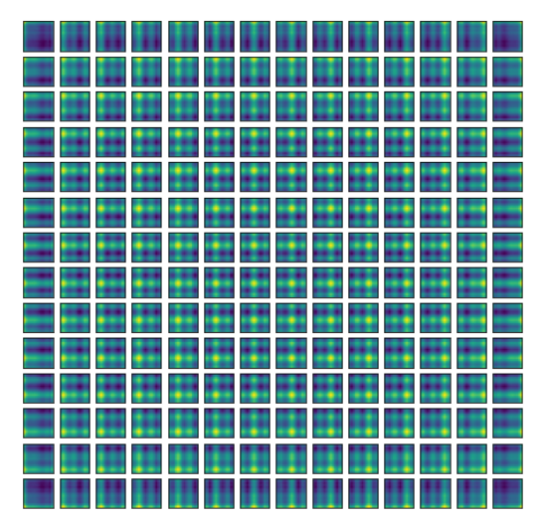
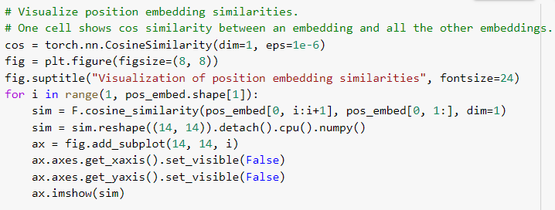
Position Embeddings Visualisation

Slide 36
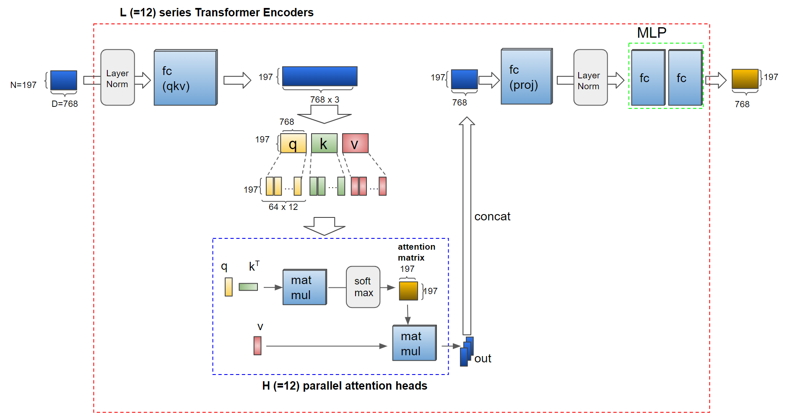
Split the image into patches and encode each patch
Add Position Embeddings
Transformer Encoder
https://colab.research.google.com/github/hirotomusiker/schwert_colab_data_storage/blob/master/notebook/Vision_Transformer_Tutorial.ipynb#scrollTo=nI6rRunEO6bI

Slide 37
VISION TRANSFORMER
Split the image into patches and encode each patch
Add Position Embeddings
Transformer Encoder
4. MLP (Classification) Head
https://colab.research.google.com/github/hirotomusiker/schwert_colab_data_storage/blob/master/notebook/Vision_Transformer_Tutorial.ipynb#scrollTo=nI6rRunEO6bI

Slide 38
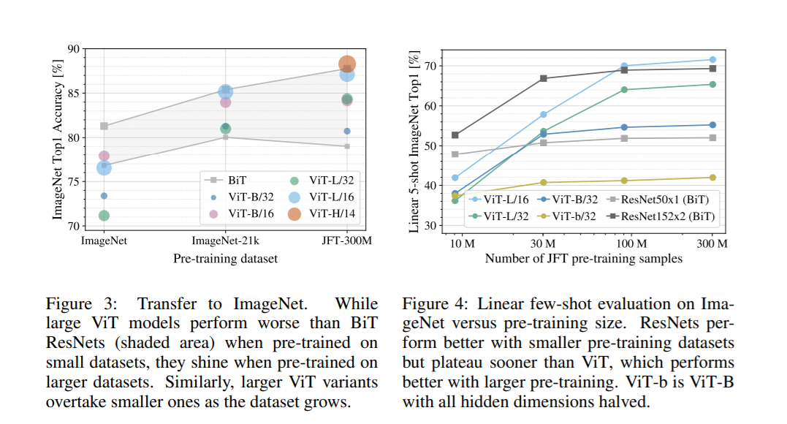

Slide 39
Recurrent Neural Networks
YOU DON'T NEED TO LEARN THIS FOR THE EXAM!!!

Slide 40

Process sequences

Slide 41
Process sequences
Image captioning,
Text generation

Slide 42
Process sequences
Action recognition
Sentiment classification

Slide 43
Process sequences
Text translation
Video classification at frame level

Slide 44
RNN cell
Recurrent core cell
Input: x^{<t>}
Internal hidden state: h^{<t>}
updated each time an input x^{<t>} is fed to the cell
Output: y^{<t>}
at some time steps
y^{<t>}
RNN cell h^{<t>}
x^{<t>}

Slide 45
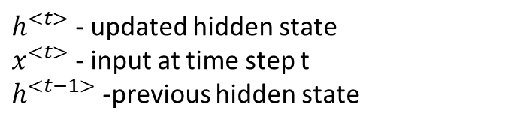
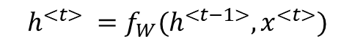
RNN cell
$$h^{<t>} =f_{W}(h^{<t−1>},x^{<t>})$$
$h^{<t>}$ - updated hidden state
$x^{<t>}$ - input at time step t
$h^{<t−1>}$ -previous hidden state
y^{<t>}
RNN cell
x^{<t>}

Slide 46
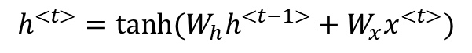
RNN cell
$$h^{<t>} =f_{W}(h^{<t−1>},x^{<t>})$$
$h^{<t>}$ - updated hidden state
$x^{<t>}$ - input at time step t
$h^{<t−1>}$ -previous hidden state
y^{<t>}
RNN cell
$$h^{<t>}=tanh⁡(W_{h}h^{<t−1>}+W_{x}x^{<t>})$$
x^{<t>}
nonlinearity

Slide 47
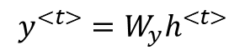
RNN cell
$$h^{<t>} =f_{W}(h^{<t−1>},x^{<t>})$$
$h^{<t>}$ - updated hidden state
$x^{<t>}$ - input at time step t
$h^{<t−1>}$ -previous hidden state
y^{<t>}
RNN cell
$$h^{<t>}=tanh⁡(W_{h}h^{<t−1>}+W_{x}x^{<t>})$$
x^{<t>}
$y^{<t>}$ : make a decision based on $h^{<t>}$ each time step
$$y^{<t>}=W_{y}h^{<t>}$$

Slide 48
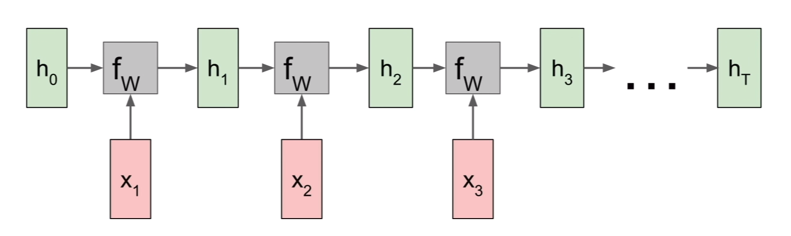
RNN computational graph
Initialized to 0 in most contexts
https://calvinfeng.gitbook.io/machine-learning-notebook/supervised-learning/recurrent-neural-network/recurrent_neural_networks

Slide 49
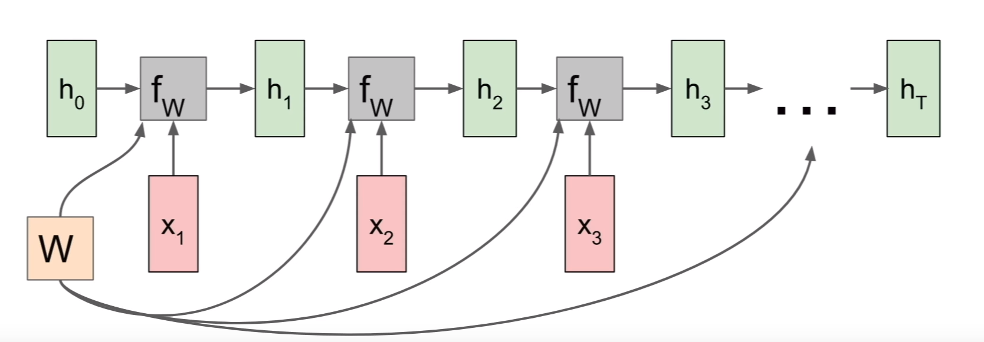
RNN computational graph
We use the same set of weight for every time step of the computation.
Backprop
Separate gradient for each W (from each of the timestamps)
Total gradient: sum of the timestamp gradients
https://calvinfeng.gitbook.io/machine-learning-notebook/supervised-learning/recurrent-neural-network/recurrent_neural_networks

Slide 50

RNN computational graph Many to one
https://calvinfeng.gitbook.io/machine-learning-notebook/supervised-learning/recurrent-neural-network/recurrent_neural_networks

Slide 51
RNN computational graph Many to one
Make decision on the last hidden state
(it summarizes the entire sequence)
https://calvinfeng.gitbook.io/machine-learning-notebook/supervised-learning/recurrent-neural-network/recurrent_neural_networks

Slide 52

RNN computational graph Many to many
Compute loss at each timestamp
https://calvinfeng.gitbook.io/machine-learning-notebook/supervised-learning/recurrent-neural-network/recurrent_neural_networks

Slide 53


RNN backward pass
During backpropagation from the next state to the current state we pass through a matrix multiplication step

Slide 54

RNN backward pass
At each cell we multiply by many factors of the weight matrix W
> 1: exploding gradients (gradient clipping): scale the value of the gradient if it is too big
< 1: vanishing gradients

Slide 55




Long short term memory, 1997
Alleviate the problems of vanishing and exploding gradient
RNN
LSTM
$$h_{t}=tanh⁡(W \left({h_{t−1} \atop x_{t}}\right))$$
Two hidden states:
c – cell state
h – hidden state

Slide 56
Long short term memory
Concatenate previous hidden state cell with the current input and multiply them with a bigger weight matrix to compute four gates

Slide 57

LSTM cell

Slide 58
Long short term memory
Concatenate previous hidden state cell with the current input and multiply them with a bigger weight matrix to compute four gates
forget gate: whether to erase cell (how much we want to forget from the previous cell state?)
input gate: whether to write to cell (how much to input into our cell?)
gate gate: how much to write to cell (how much to write into our cell?)
output gate: how much to reveal cell (how much to reveal from ourselves to the outside?

Slide 59
Long short term memory
Sigmoid: [0, 1]
tanh: [-1, 1]
Element wise multiplication: forget that element of the cell (0), or remember it (1)
forget gate: whether to erase cell (how much we want to forget from the previous cell state?)
input gate: whether to write to cell (how much to input into our cell?)
gate gate: how much to write to cell (how much to write into our cell?)
output gate: how much to reveal cell (how much to reveal from ourselves to the outside?

Slide 60
Long short term memory
Sigmoid: [0, 1]
tanh: [-1, 1]
Element wise multiplication: for each element of the cell state, do we want to write to (1) it or not (0)?
forget gate: whether to erase cell (how much we want to forget from the previous cell state?)
input gate: whether to write to cell (how much to input into our cell?)
gate gate: how much to write to cell (how much to write into our cell?)
output gate: how much to reveal cell (how much to reveal from ourselves to the outside?

Slide 61
Long short term memory
Sigmoid: [0, 1]
tanh: [-1, 1]
Element wise multiplication: the candidate value that we might consider writing to the current cell state [-1, 1]
Independent scaler values, incremented of decrement by 1
forget gate: whether to erase cell (how much we want to forget from the previous cell state?)
input gate: whether to write to cell (how much to input into our cell?)
gate gate: how much to write to cell (how much to write into our cell?)
output gate: how much to reveal cell (how much to reveal from ourselves to the outside?

Slide 62
Long short term memory
Sigmoid: [0, 1]
tanh: [-1, 1]
Use the cell state to compute a hidden state which we will reveal to the outside world
Sigmoid: for each element of out cell state, do we want to reveal it or not?
forget gate: whether to erase cell (how much we want to forget from the previous cell state?)
input gate: whether to write to cell (how much to input into our cell?)
gate gate: how much to write to cell (how much to write into our cell?)
output gate: how much to reveal cell (how much to reveal from ourselves to the outside?

Slide 63

LSTM cell

